Slide 1

Leave Management System
Vidhi Shah
Pragya Gautam
Reetika Goel
Sithara Krishnamurthy
CMPE – 272: Enterprise Software Platform
Notes:
Reference: http://www.sjsu.edu/

Slide 2
Introduction
Employee management is an important aspect of any organization. Functionalities such as applying for leaves, viewing employee details, etc. are necessary.
This project aims at creating a Leave Management System for an enterprise.
User will be able to perform functionalities depending on their role-
login to account
view user profile
Apply for leaves
view leave history
approve/reject leaves
generate custom reports
The portal consists of multiple pages to perform these functionalities
The available roles are
Employee - view profile and apply for leave.
Manager - view profile, apply for leave and approve leave
HR – approve leaves

Slide 3
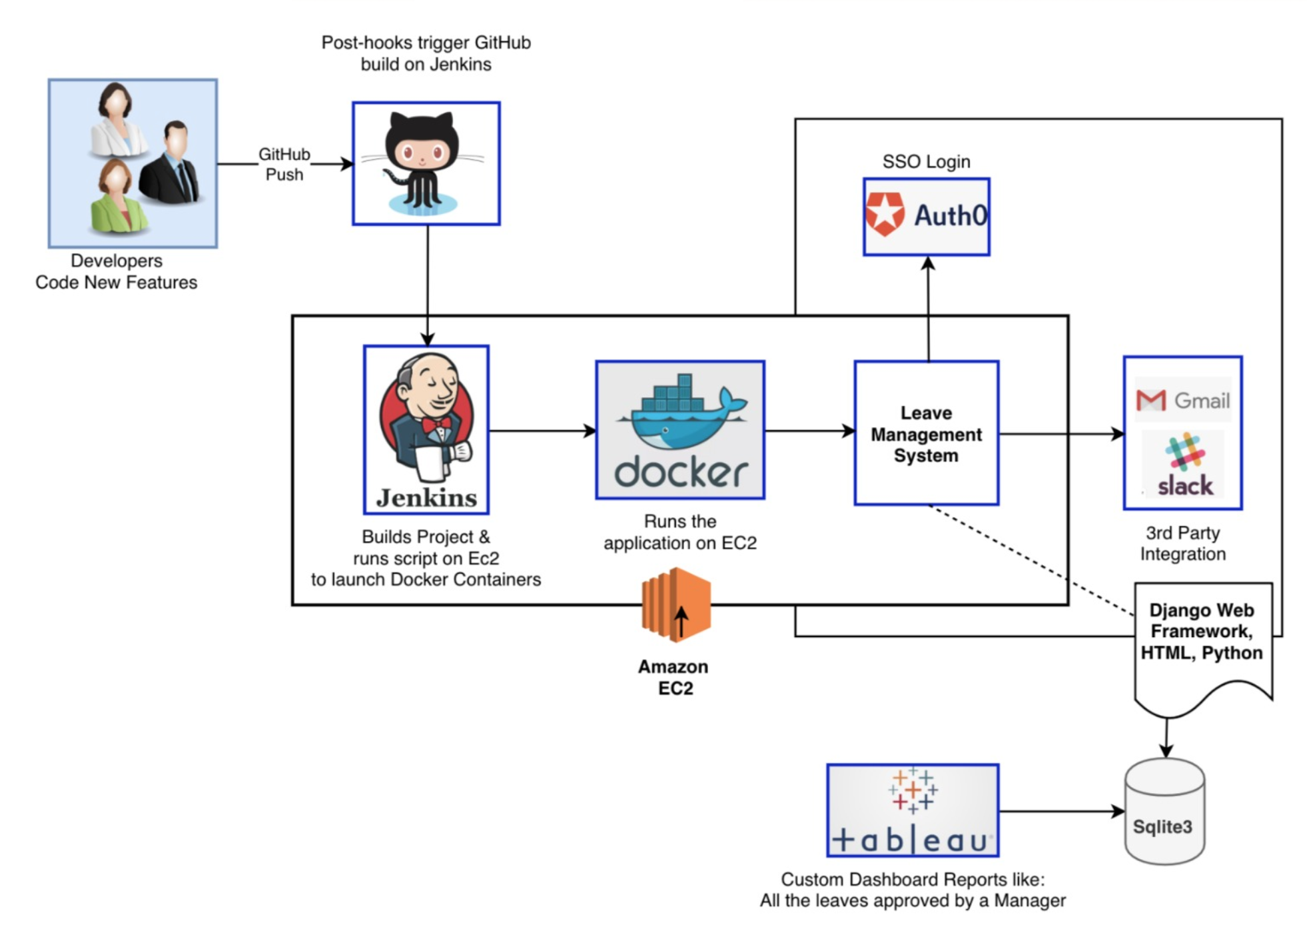
Architecture Diagram
Notes:
https://github.com/
https://www.evensi.us/devops-philosophy-practice-pj-hagerty-crate-triangle-group-cloudbees/255341315
https://blog.docker.com/2013/06/announcing-new-docker-style/
https://siliconangle.com/2013/05/21/after-ipo-dont-expect-tableau-to-follow-the-beaten-path-from-consumer-cloud-to-enterprise/tableau-logo-use-this-one/
https://www.pcr-online.biz/resellers/auth0-sees-150-growth-in-partner-program
http://www.logosvectorfree.com/gmail-logo-icons-vector-png-free-download/
https://www.pinterest.com/pin/129267451779877153/

Slide 4
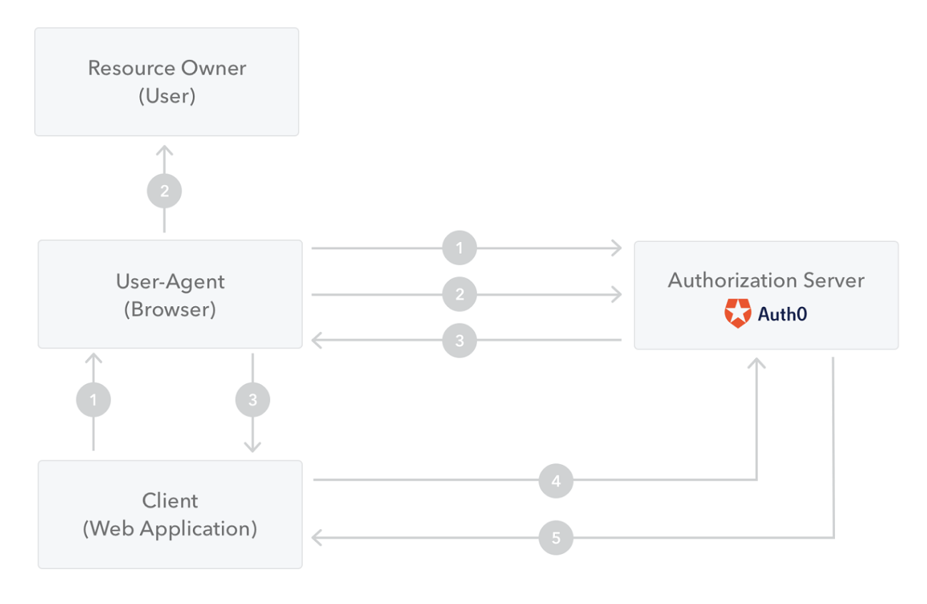
Auth0 Architecture
The Application initiates the flow and redirects the user to the Authorization Server.
The user authenticates.
The Authorization Server redirects to the redirect_uri with a code in the query string.
The Application sends the code together with the Client ID, Client Secret and redirect_uri to the Authorization Server.
The Authorization Server validates this information and returns an ID Token.

Slide 5
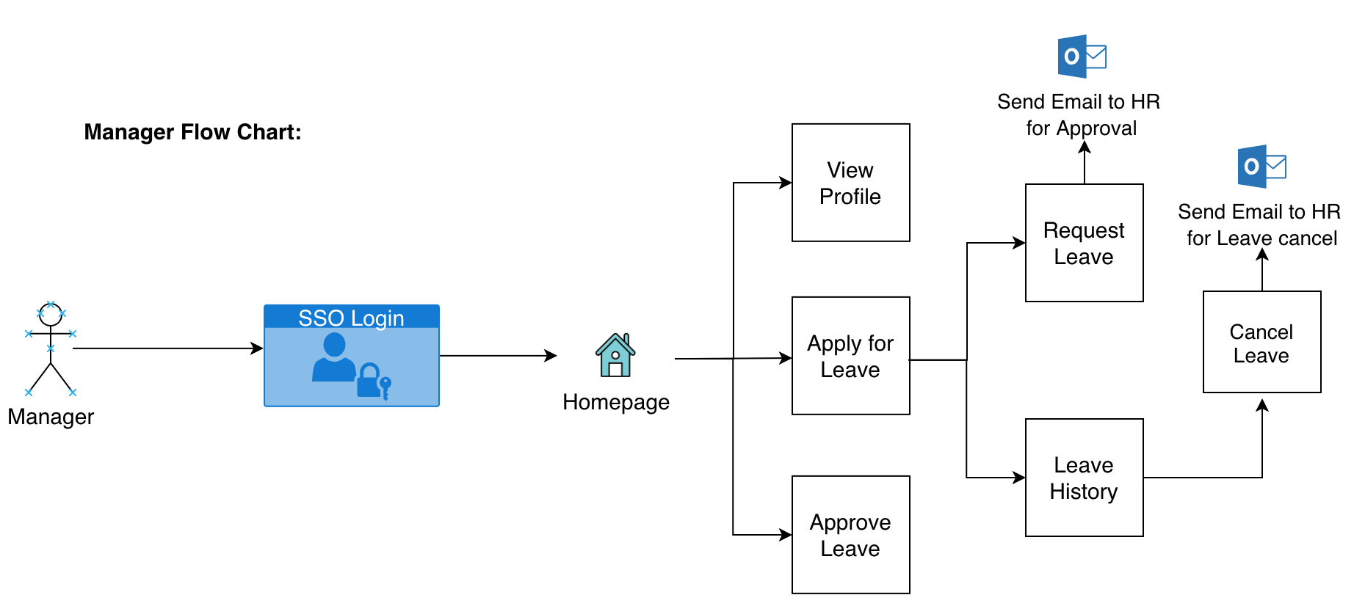
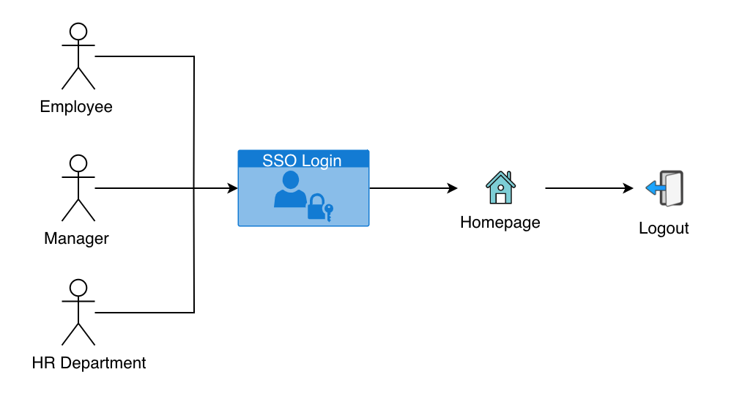
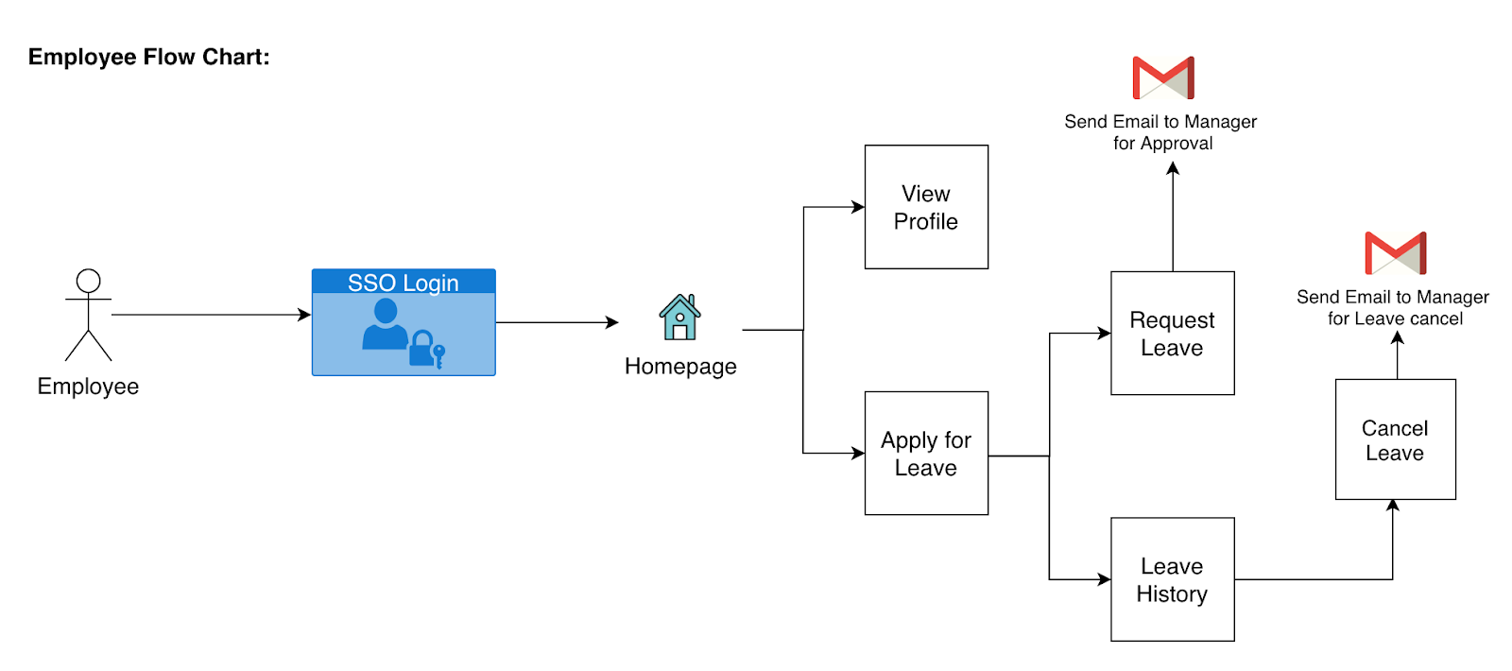
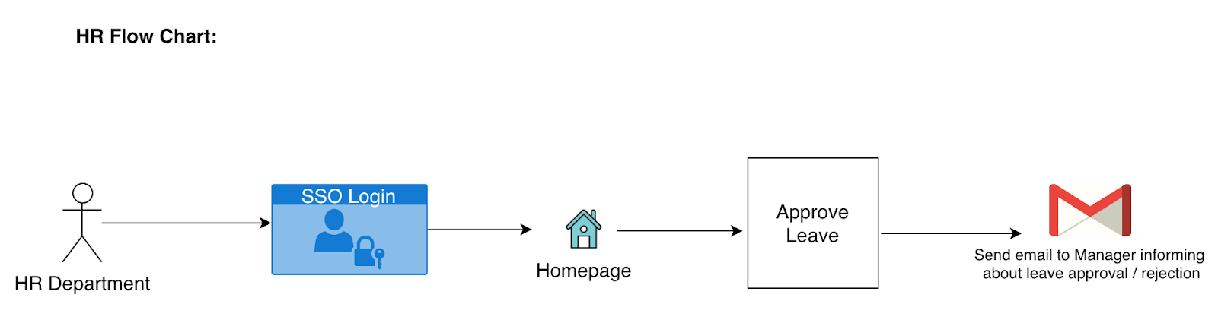

Slide 6
Project Risks Infrastructure Risk
Heavy dependence on AWS infrastructure
SSO is from a third party, they could limit the number of calls we have.
Project Assumptions and Risks:
Unapproved leaves will not be auto approved in the system Project Assumptions
Assume that all the information entered by the user will be correct
Employee accounts are already registered in the system and are active
HR account is managed by group of individuals
As per role hierarchy, manager is an acting entity for employee leaves and HR manages manager leaves
The manager will always be responsive approving and declining leaves.

Slide 7
Tableau

Slide 8
Demo - http://13.52.79.32:8000/LMS/TheSeekers/
Jenkins - http://13.52.79.32:8080/
Notes:
https://www.w3schools.com/w3css/tryw3css_templates_coming_soon.htm

Slide 9
Conclusion
Reduce Hassel/Paperwork
Simple-Time Off Booking
Clear Visibility
Powerful HR/Manager Reporting Solution
Automatic Leave Tracking
Easy Leave Planning

